Slide 1
Introduction to Docker
Basics of building Docker images, sharing them using image registries, orchestrating systems with Docker, and much more.
PRESENTED BY:
Sergey Tantsyura
Maxim Nakhod
Date: October 17, 2019

Slide 2
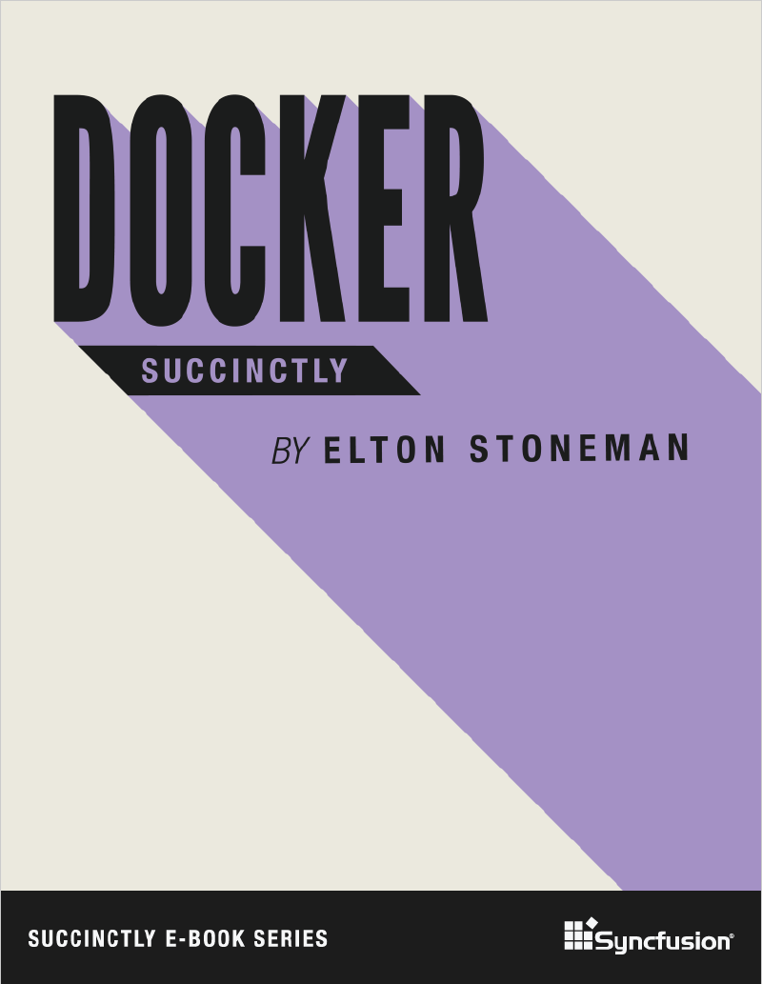
Disclaimer
Content of this training is based on Docker Succinctly e-book.
Succinctly e-book series is a great way to quickly get familiar with new technologies. These e-books are free and most of them are between 50 and 100 pages.

Slide 3
Agenda
01
02
03
04
05
06
Introducing Docker
Creating Docker images
Image registries and Docker Hub
Data Storage in Docker
Orchestrating Systems with Docker
Clustering Hosts with Docker Swarm
Notes:
01, 03, 05, 07 (??????????????????????) – STA
02, 04, 06 – MN
Samples:
01
run SQL server Linux container
Run some windows container
02
create ASP.NET Core app and package it into container
Multi-stage build, first stage builds from sources, second stage packages output of first stage
03 – push created image to image registry, show script
MN to provide link to registry + set access rights
04
add logging, show how to mount folder where logs will be written to.
??? – use folder for DB files in SQL server
05
Start SQL + web app simultaneously, pass connection string to sql server via env variable
+ update web app to use data from DB
06
Run apps from 05 in Docker Swarm
07
??????????????????????????????????????? Kubernetes

Slide 4
Introducing Docker

Slide 5
Header
Content

Slide 6
Creating Docker images

Slide 7
Header
Content

Slide 8
Image registries and Docker Hub

Slide 9
Header
Content

Slide 10
Data Storage in Docker

Slide 11
Header
Content

Slide 12
Orchestrating Systems with Docker

Slide 13
Header
Content

Slide 14
Clustering Hosts with Docker Swarm

Slide 15
Header
Content

Slide 16
Q&A

